Slide 1
Library Independence Regarding User and Fulfillment Activities
Yoel Kortick
Senior Librarian

Slide 2


All features listed here as “New” require that a system-wide customer parameter be defined. To have this parameter defined please contact Ex Libris support.
Introduction
The sample staff users, patrons and items
Patrons can loan items only according to their scope (existed already and not parameter-dependent)
Staff users can loan to patrons only items associated with a circulation desk for which they have permission (existed already and not parameter-dependent)
Viewing patron loans restricted by library (New)
Viewing patron requests restricted by library (New)
Creating and Viewing Fines and Fees restricted by library (New)
Creating and Viewing Notes restricted by library (New)
Creating and Viewing Blocks restricted by library (New)
Creating and Viewing Attachments restricted by library (New)

Slide 3
Introduction

Slide 4
Introduction
In order to ensure patron privacy in Alma, a full separation of user and fulfillment activities by libraries has been established.
A patron’s activities and entities are associated with a specific library, and then can be viewed only by staff users with permissions in the specific library.
In this manner, for example, a patron's loans, requests, fines and fees, attachments, notes, etc. in the Law Library can only be viewed by a staff user associated with the Law Library. A staff user associated only with the Medical Library will not be able to view them.

Slide 5
Introduction
This functionality is dependent on a parameter in Alma.
If the institution desires to use this functionality a case should be opened for Ex Libris support.
Note that the ability to loan to a patron only items from a specific library has always existed in Alma and is not dependent on any specific parameter. It is dependent on the scope of the “Patron” role. This is included in this presentation because even though it is not new, it still is an aspect of “Library Independence”.

Slide 6
The sample staff users, patrons and items.

Slide 7
The sample staff users, patrons and items
Staff user Jethro Bodine is associated with the Medical Library.
He has the following roles and scopes:
  User Manager in scope Medical Library
  Requests Operator in scope Medical Library
  Circulation Desk Manager in scope Medical Library
  Circulation Desk Operator in scope Medical Library

Slide 8
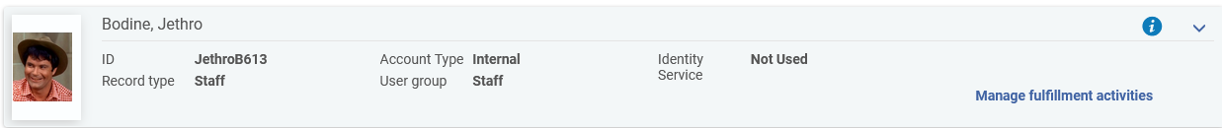
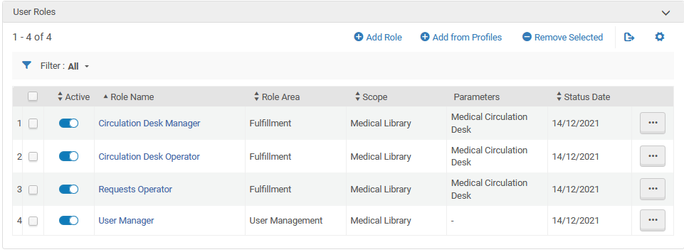
The sample staff users, patrons and items

Slide 9
The sample staff users, patrons and items
Staff user Elly May Clampett is associated with the Law Library.
She has the following roles and scopes:
  User Manager in scope Law Library
  Requests Operator in scope Law Library
  Circulation Desk Manager in scope Law Library
  Circulation Desk Operator in scope Law Library

Slide 10
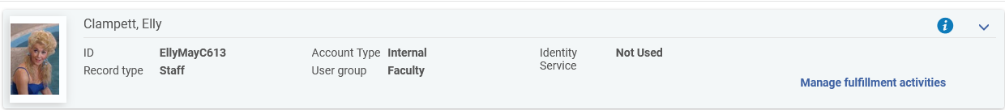
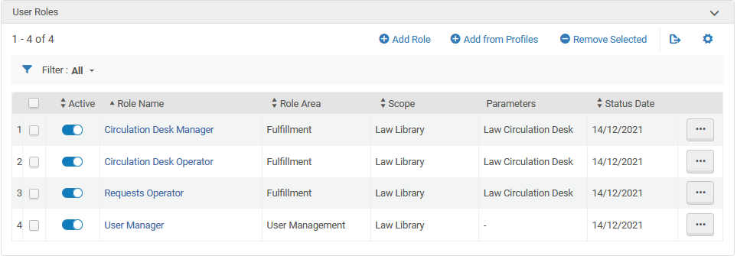
The sample staff users, patrons and items

Slide 11
The sample staff users, patrons and items
Patron Marsha Brady has role “Patron” in the Medical Library.
Patron Greg Brady has role “Patron” in the Law Library.
Patron Moshe Ben Maimon has role “Patron” in the Medical Library and the Law Library.

Slide 12
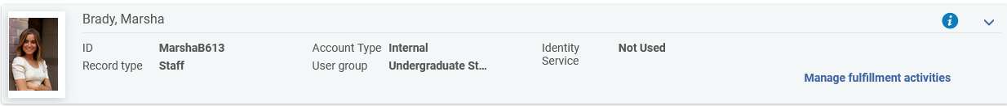
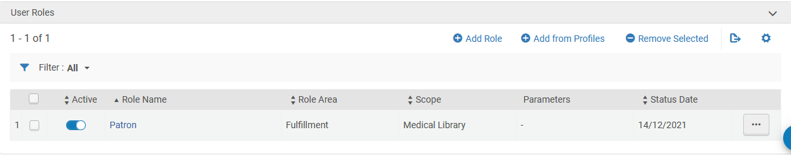
The sample staff users, patrons and items
Patron Marsha Brady has role “Patron” in the Medical Library.

Slide 13
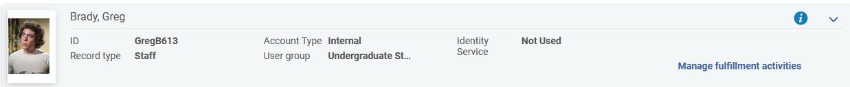
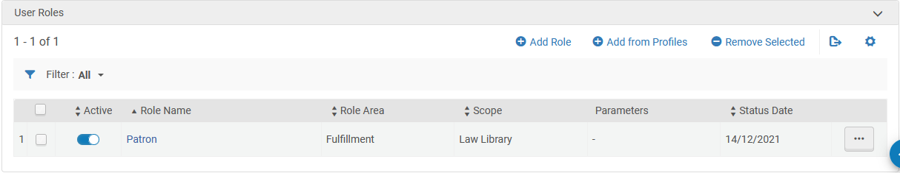
The sample staff users, patrons and items
Patron Greg Brady has role “Patron” in the Law Library.

Slide 14
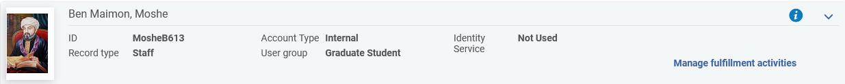
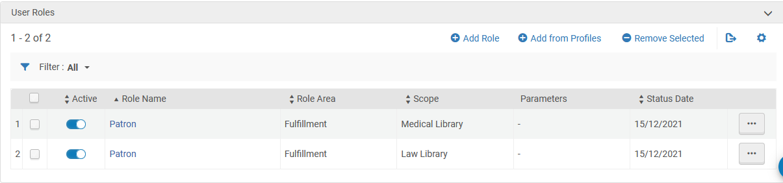
The sample staff users, patrons and items
Patron Moshe Ben Maimon has role “Patron” in the Medical Library and the Law Library

Slide 15
The sample staff users, patrons and items
Item barcode 20211214-001 is in the Law Library.
Item barcode 20211214-002 is in the Medical Library.

Slide 16
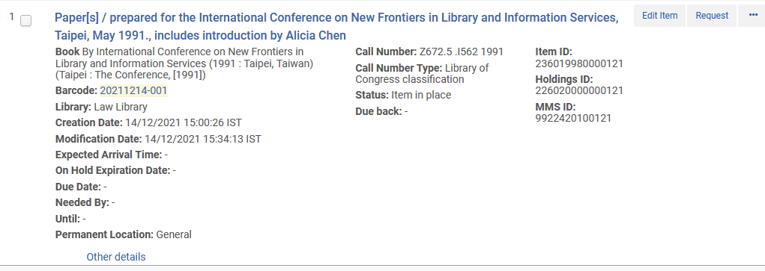
The sample staff users, patrons and items
Item barcode 20211214-001 is in the Law Library.

Slide 17
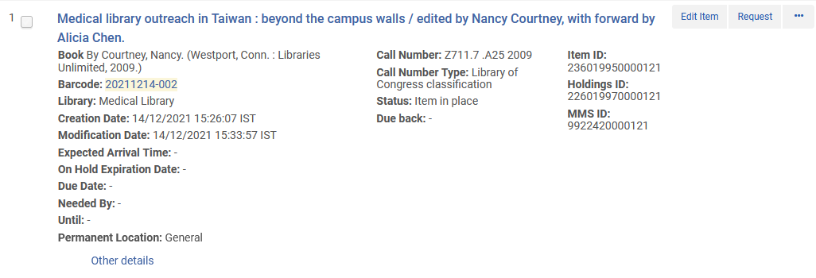
The sample staff users, patrons and items
Item barcode 20211214-002 is in the Medical Library.

Slide 18
Patrons can loan items only according to their scope

Slide 19
Patrons can loan items only according to their scope
It is possible to limit the items which a patron can loan according to the library of the item.
This is done by using the scope of the Patron role.
We saw that Marsha Brady has one patron role and it is in library “Medical Library”. This means that she can only loan items from the Medical Library.
We saw that Greg Brady has one patron role and it is in library “Law Library”. This means that he can only loan items from the Law Library.

Slide 20
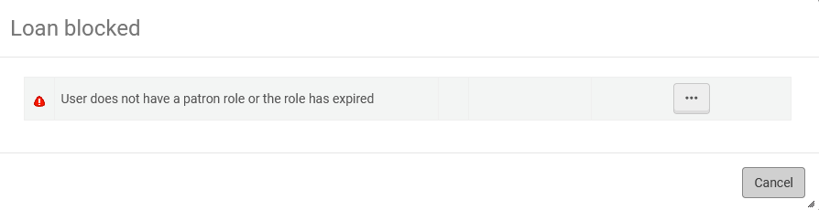
Patrons can loan items only according to their scope
Item barcode 20211214-001 (in the Law Library) cannot be loaned to Marsha Brady because she has a patron role only in the Medical Library.

Slide 21
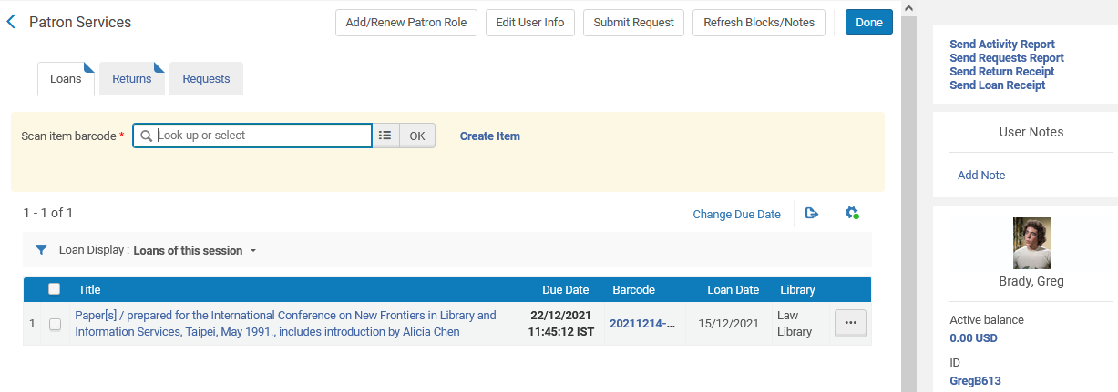
Patrons can loan items only according to their scope
Item barcode 20211214-001 (in the Law Library) can be loaned to Greg Brady because his patron role is in the Law library.

Slide 22
Patrons can loan items only according to their scope
Item barcode 20211214-002 (in the Medical Library) cannot be loaned to Greg Brady because he has a patron role only in the Law Library.

Slide 23
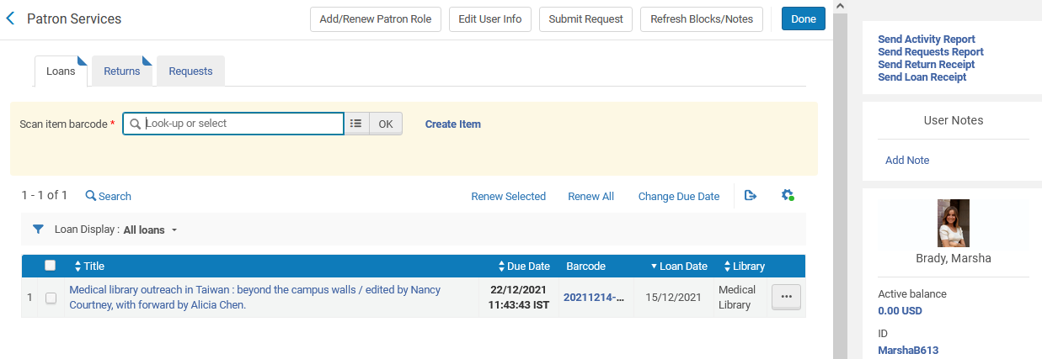
Patrons can loan items only according to their scope
Item barcode 20211214-002 (in the Medical Library) can be loaned to Marsha Brady because her patron role is in the Medical library.

Slide 24
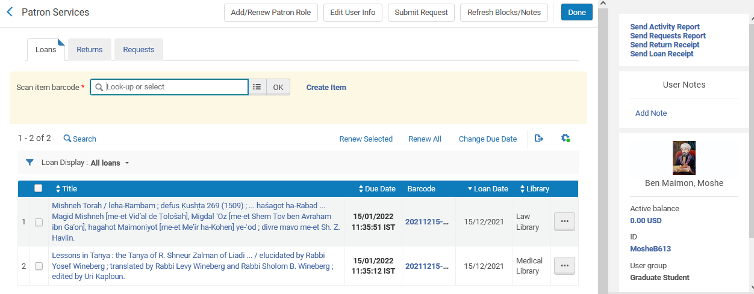
Patrons can loan items only according to their scope
Moshe Ben Maimon can loan items in either the Law Library or the Medical Library because he has a patron role in both.

Slide 25
Staff users can loan to patrons only items associated with a circulation desk for which they have permission

Slide 26
Staff users can loan to patrons only items associated with a circulation desk for which they have permission
We saw that our two staff users have permission for one circulation desk each:
Elly May Clampett is
  Circulation Desk Manager in scope Law Library
  Circulation Desk Operator in scope Law Library
Jethro Bodine is
  Circulation Desk Manager in scope Medical Library
  Circulation Desk Operator in scope Medical Library

Slide 27
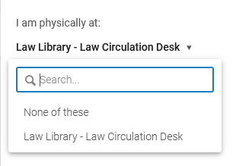
Staff users can loan to patrons only items associated with a circulation desk for which they have permission
When Elly May Clampett is logged in, she can only access the Law Library Circulation Desk

Slide 28
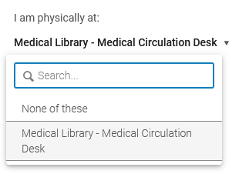
Staff users can loan to patrons only items associated with a circulation desk for which they have permission
When Jethro Bodine is logged in, he can only access the Medical Library Circulation Desk

Slide 29
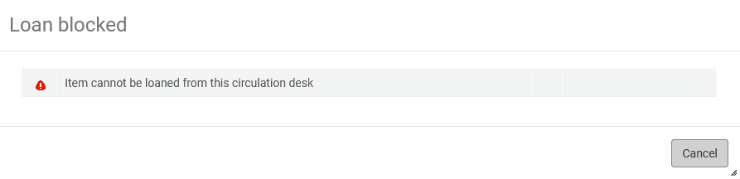
Staff users can loan to patrons only items associated with a circulation desk for which they have permission
If Elly May Clampett or Jethro Bodine will try to loan item belonging to a library which is not associated with their circulation desk they will not be allowed to:

Slide 30
Staff users can loan to patrons only items associated with a circulation desk for which they have permission
This means that
  Elly May Clampett can only loan to patrons items which are in the Law library
  Jethro Bodine can only loan to patrons items which are in the Medical library
Note that it is also possible to “further configure” this setup using the “Relationships” at “Configuration > Select a Library > General > Libraries > Relationships. This however is beyond the scope of our discussion.

Slide 31
Viewing patron loans restricted by library

Slide 32
Viewing patron loans restricted by library
What we will see in this section: Each staff user can only see loans of a patron depending on the library to which he or she is associated via the circulation desk and user manager roles.

Slide 33
Viewing patron loans restricted by library
We have already seen that patron Moshe Ben Maimon has loans from two different libraries.
Staff user Alicia Chen has roles circulation desk operator and circulation desk manager in both libraries and therefore can see loans from both libraries.
  “Another reason” Alicia Chen can see loans from both libraries is because she has role “User Administrator” which can be configured only on the entire institution level.

Slide 34
Viewing patron loans restricted by library
Staff user Jethro Bodine can see loans only from the Medical Library because he has roles circulation desk operator and circulation desk manager only in the Medical Library
Staff user Elly May Clampett can see loans only from the Law Library because she has roles circulation desk operator and circulation desk manager only in the Law Library

Slide 35
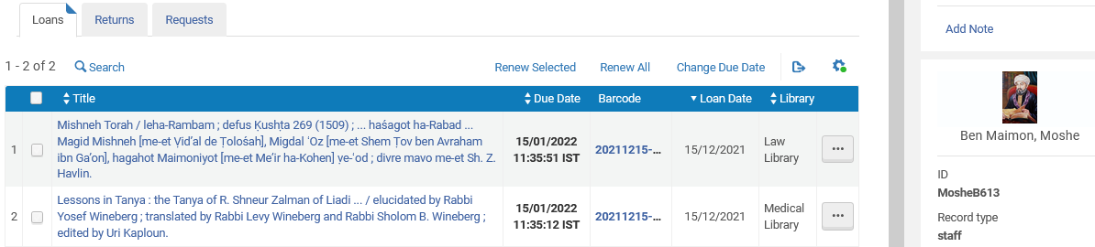
Viewing patron loans restricted by library
Staff user Alicia Chen sees loans from both libraries

Slide 36
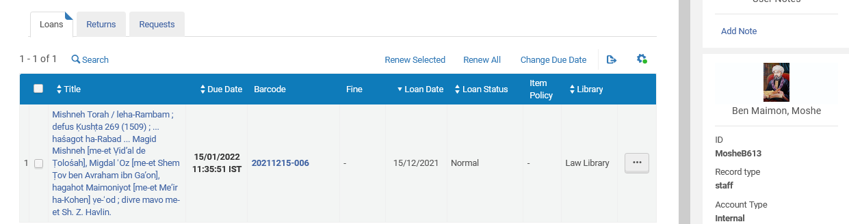
Viewing patron loans restricted by library
Staff user Elly May Clampett sees loans from only the Law Library

Slide 37
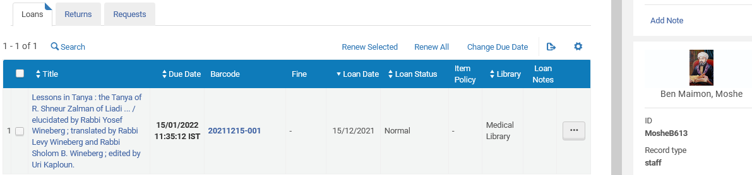
Viewing patron loans restricted by library
Staff user Jethro Bodine sees loans from only the Medical Library

Slide 38
Viewing patron requests restricted by library

Slide 39
Viewing patron requests restricted by library
What we will see in this section: Each staff user can only see requests of a patron depending on the library to which he or she is associated via the scope of the request operator role.

Slide 40
Viewing patron requests restricted by library
Staff user Jethro Bodine can see requests only from the Medical Library because he has role Requests Operator only in the Medical Library
Staff user Elly May Clampett can see requests only from the Law Library because she has roles Requests Operator only in the Law Library
Staff user Alicia Chen has Requests Operator role in the institution and therefore sees requests from all libraries.

Slide 41
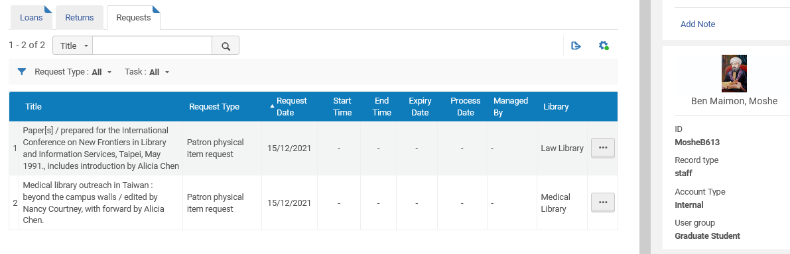
Viewing patron requests restricted by library
Staff user Alicia Chen has requests operator role in the institution and therefore sees requests from all libraries:

Slide 42
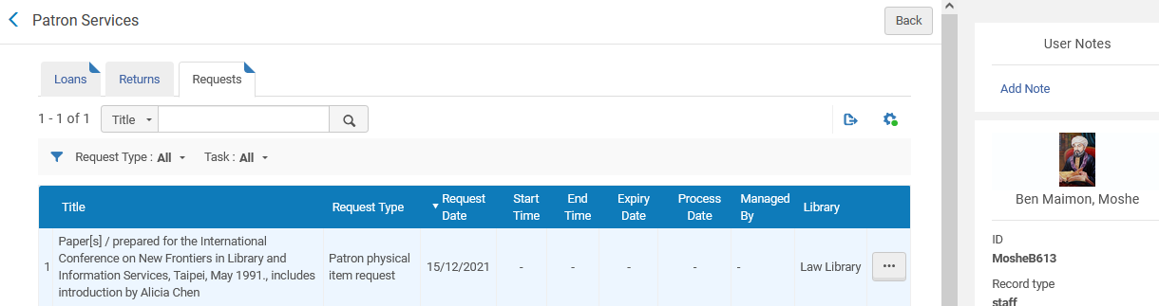
Viewing patron requests restricted by library
Staff user Elly May Clampett sees requests from only the Law Library

Slide 43
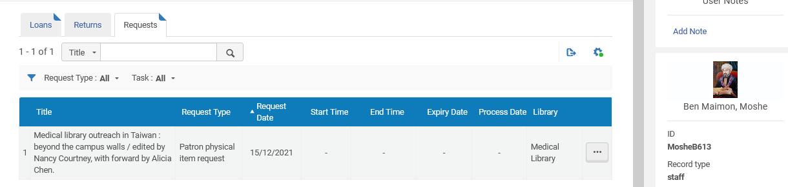
Viewing patron requests restricted by library
Staff user Jethro Bodine sees requests from only the Medical Library

Slide 44
Creating and Viewing Fines and Fees restricted by library

Slide 45
Creating and Viewing Fines and Fees restricted by library
What we will see in this section:
  A field “Owner” which is part of the Fines and Fees.
  This allows the institution to restrict which staff users can see and add which Fines and Fees.

Slide 46
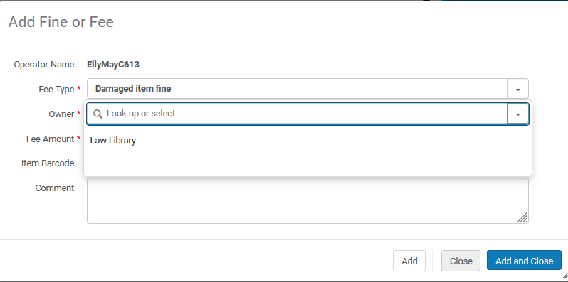
Creating and Viewing Fines and Fees restricted by library
Staff user Elly May Clampett can create Fines and Fees only for the Law Library

Slide 47
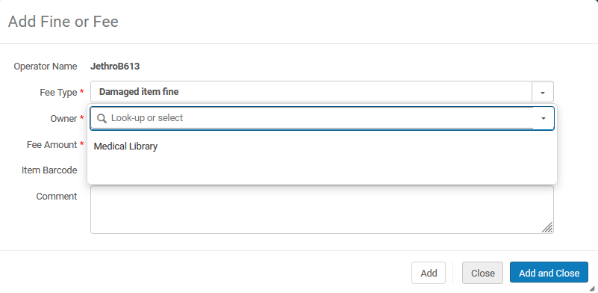
Creating and Viewing Fines and Fees restricted by library
Staff user Jethro Bodine can create Fines and Fees only for the Medical Library

Slide 48
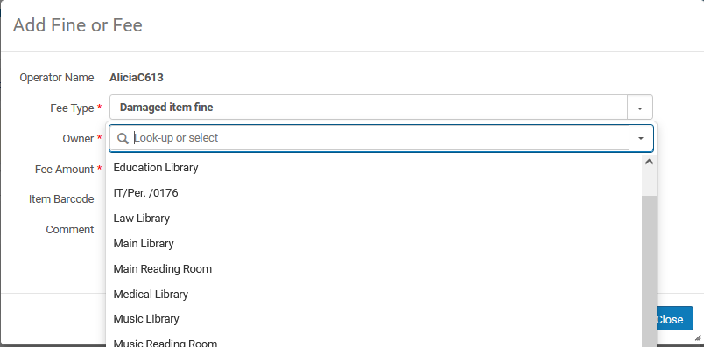
Creating and Viewing Fines and Fees restricted by library
Staff user Alicia Chen can create Fines and Fees for any library

Slide 49
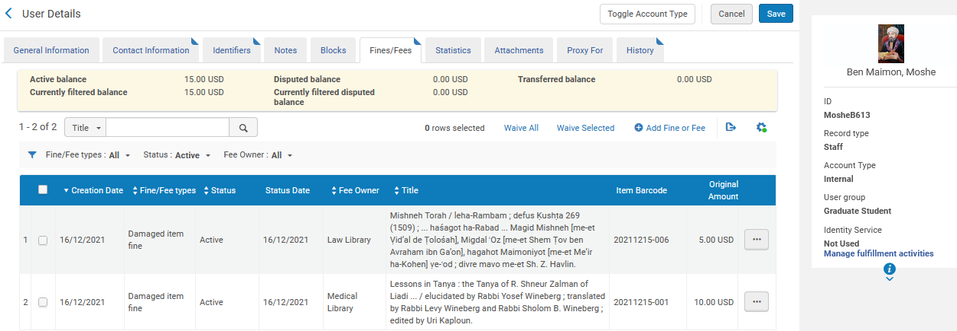
Creating and Viewing Fines and Fees restricted by library
Patron Moshe Ben Maimon has fines and fees in the Law Library and Medical Library.

Slide 50
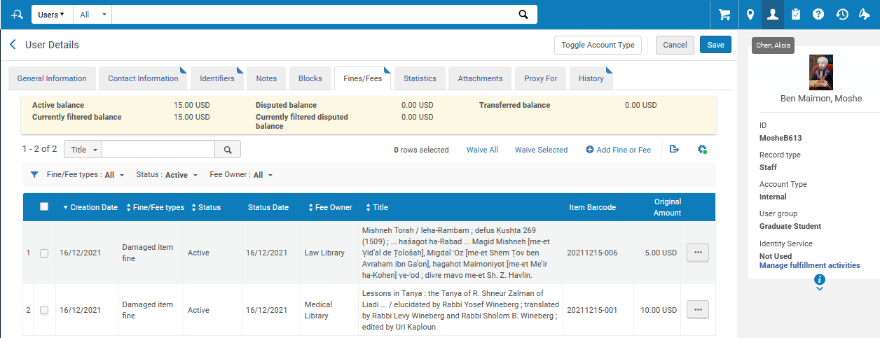
Creating and Viewing Fines and Fees restricted by library
Staff user Alicia Chen sees fees fines and fees in the Law Library and Medical Library.
Staff User Alicia Chen

Slide 51
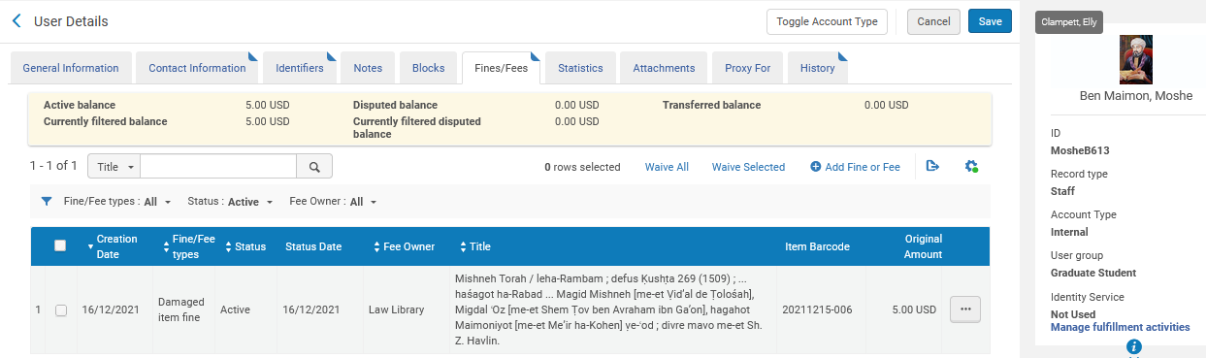
Creating and Viewing Fines and Fees restricted by library
Staff user Elly May Clampett sees fines and fees in the Law Library only.
Staff User Elly May Clampett
Law Library

Slide 52
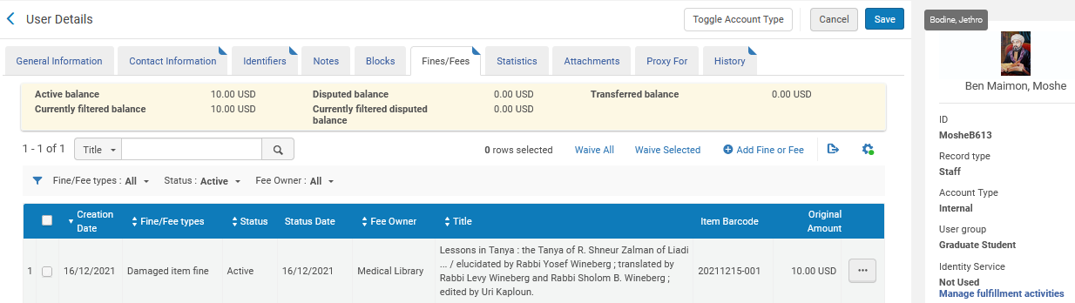
Creating and Viewing Fines and Fees restricted by library
Staff user Jethro Bodine sees fines and fees in the Medical Library only.
Staff User Jethro Bodine
Medical Library

Slide 53
Creating and Viewing Notes restricted by library

Slide 54
Creating and Viewing Notes restricted by library
What we will see in this section:
  A new field “Owner” has been added to the Notes.
  This allows the institution to restrict which staff users can see which Notes.

Slide 55
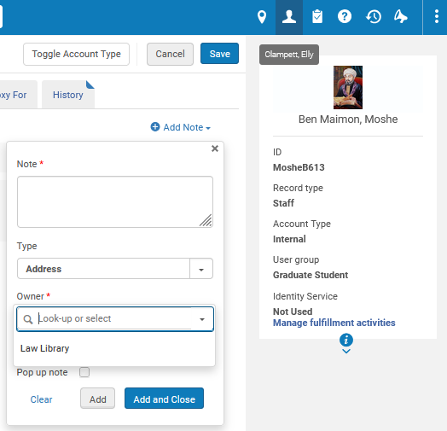
Creating and Viewing Notes restricted by library
Staff user Elly May Clampett can create Notes only for the Law Library
Staff User Elly May Clampett
Law Library

Slide 56
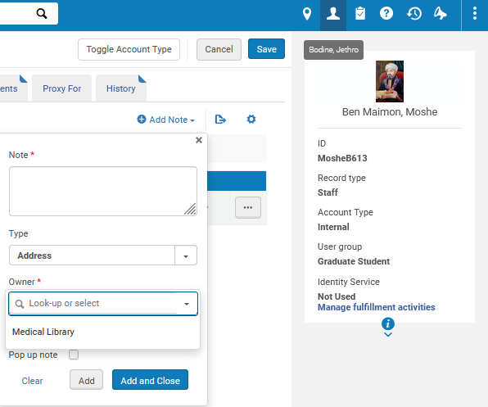
Creating and Viewing Notes restricted by library
Staff user Jethro Bodine can create Notes only for the Medical Library
Staff User Jethro Bodine
Medical Library

Slide 57
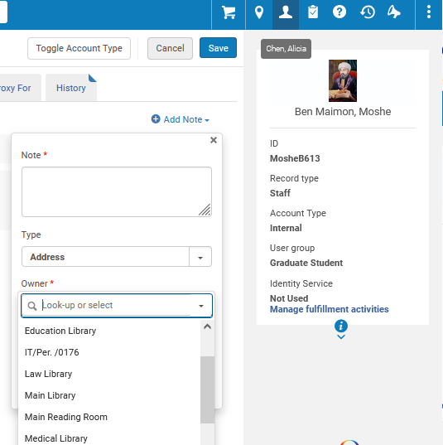
Creating and Viewing Notes restricted by library
Staff user Alicia Chen can create Notes for any library
Staff User Alicia Chen
All Libraries and institution

Slide 58
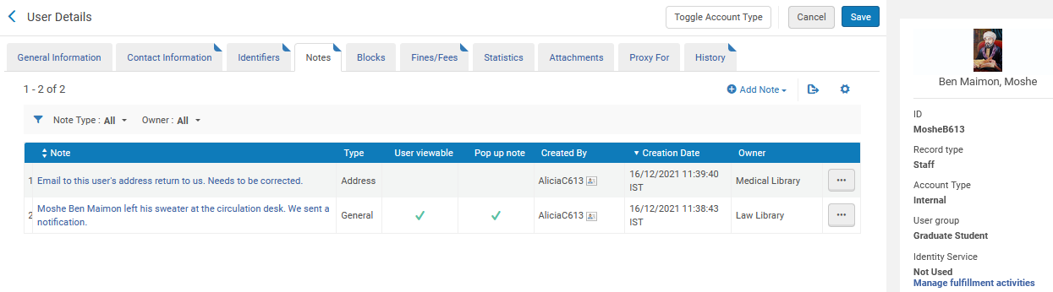
Creating and Viewing Notes restricted by library
Patron Moshe Ben Maimon has notes in the Law Library and Medical Library.

Slide 59
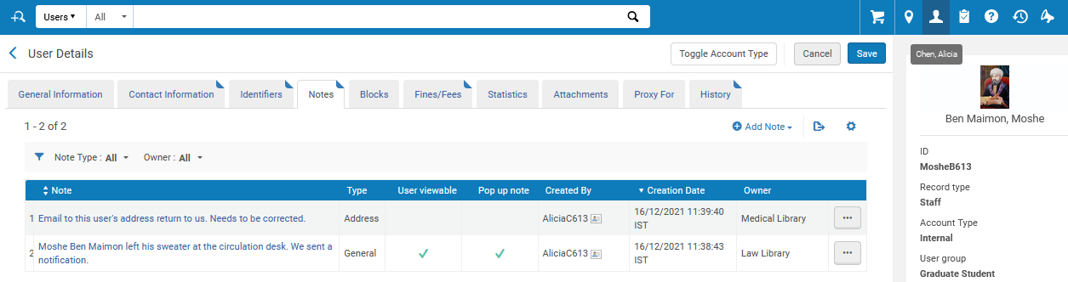
Creating and Viewing Notes restricted by library
Staff user Alicia Chen sees notes in the Law Library and Medical Library.
Staff User Alicia Chen

Slide 60
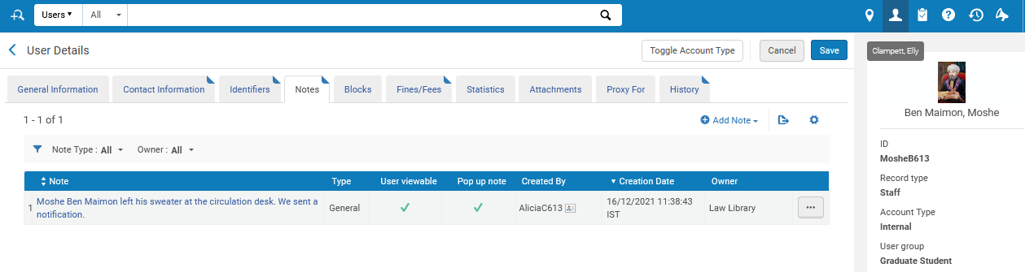
Creating and Viewing Notes restricted by library
Staff user Elly May Clampett sees notes in the Law Library only.
Staff User Elly May Clampett
Law Library

Slide 61
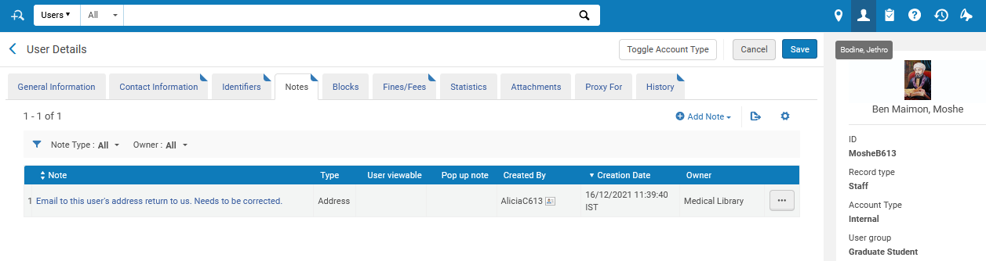
Creating and Viewing Notes restricted by library
Staff user Jethro Bodine sees notes in the Medical Library only.
Staff User Jethro Bodine
Medical Library

Slide 62
Creating and Viewing Blocks restricted by library

Slide 63
Creating and Viewing Blocks restricted by library
What we will see in this section:
  A new field “Owner” has been added to the Blocks.
  This allows the institution to restrict which staff users can see which Blocks.
  Library-level blocks also have a functional meaning: Blocks at the library level only block activity for that library’s items (while institution-level blocks block activity in all libraries)

Slide 64
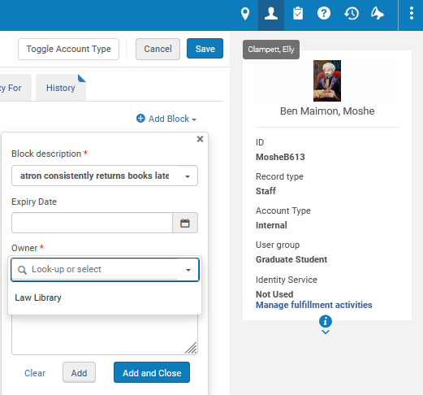
Creating and Viewing Blocks restricted by library
Staff user Elly May Clampett can create Blocks only for the Law Library
Staff User Elly May Clampett
Law Library

Slide 65
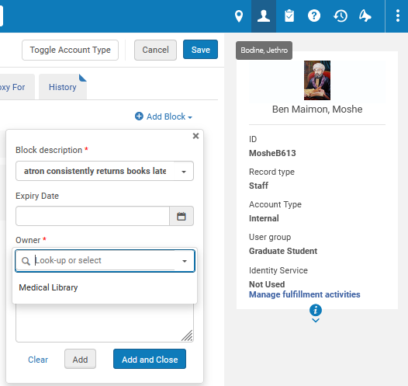
Creating and Viewing Blocks restricted by library
Staff user Jethro Bodine can create Blocks only for the Medical Library
Staff User Jethro Bodine
Medical Library

Slide 66
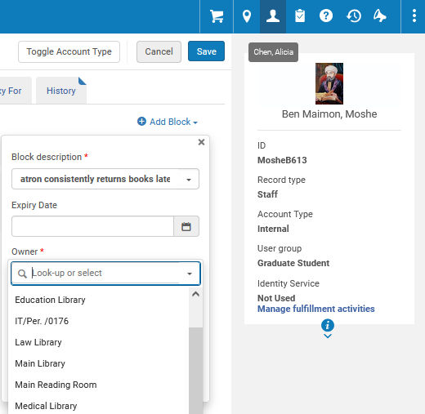
Creating and Viewing Blocks restricted by library
Staff user Alicia Chen can create Blocks for any library
Staff User Alicia Chen
All Libraries and institution

Slide 67
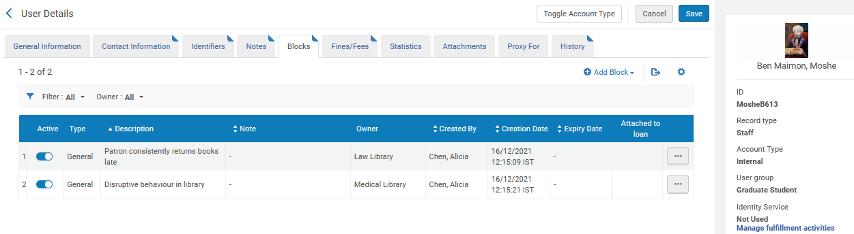
Creating and Viewing Blocks restricted by library
Patron Moshe Ben Maimon has Blocks in the Law Library and Medical Library.

Slide 68
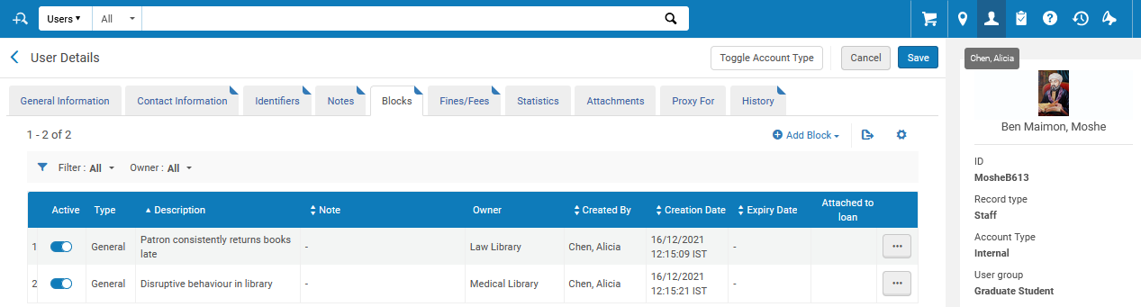
Creating and Viewing Blocks restricted by library
Staff user Alicia Chen sees blocks in the Law Library and Medical Library.
Staff User Alicia Chen

Slide 69
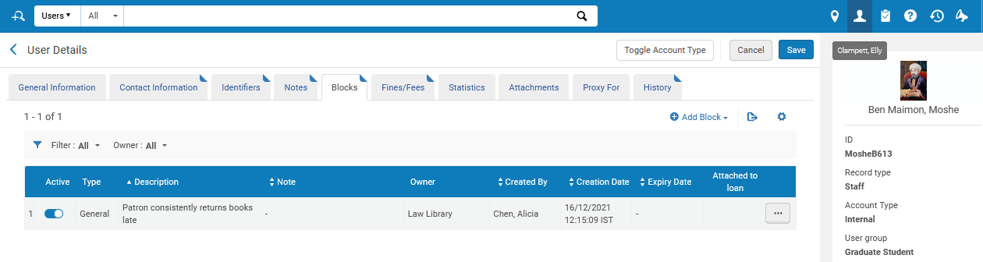
Creating and Viewing Blocks restricted by library
Staff user Elly May Clampett sees blocks in the Law Library only.
Staff User Elly May Clampett
Law Library

Slide 70
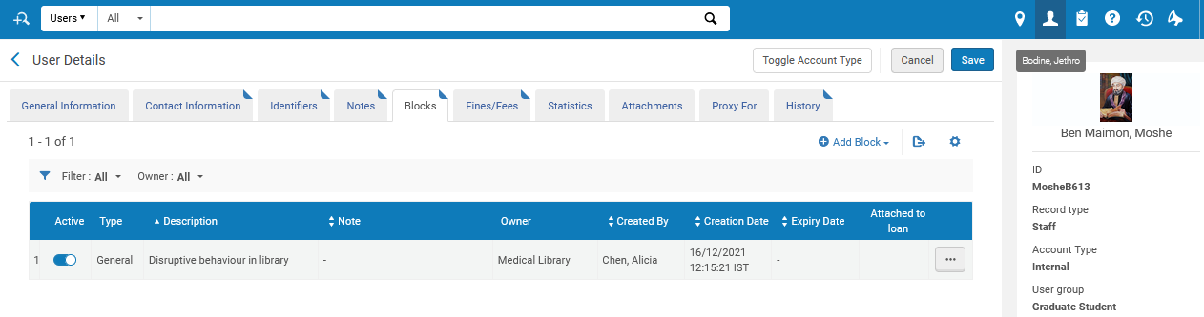
Creating and Viewing Blocks restricted by library
Staff user Jethro Bodine sees blocks in the Medical Library only.
Staff User Jethro Bodine
Medical Library

Slide 71
Creating and Viewing Attachments restricted by library

Slide 72
Creating and Viewing Attachments restricted by library
What we will see in this section:
  A new field “Owner” has been added to the Attachments.
  This allows the institution to restrict which staff users can see which Attachments.

Slide 73
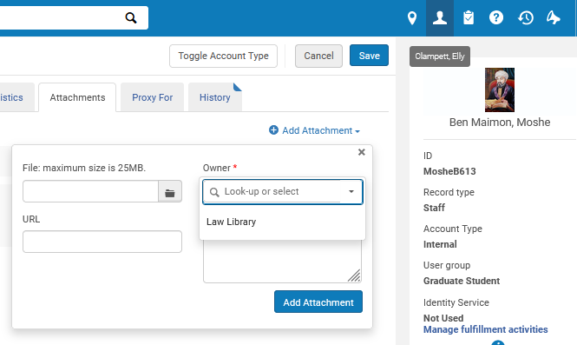
Creating and Viewing Attachments restricted by library
Staff user Elly May Clampett can create Attachments only for the Law Library
Staff User Elly May Clampett
Law Library

Slide 74

Creating and Viewing Attachments restricted by library
Staff user Jethro Bodine can create Attachments only for the Medical Library
Staff User Jethro Bodine
Law Library

Slide 75
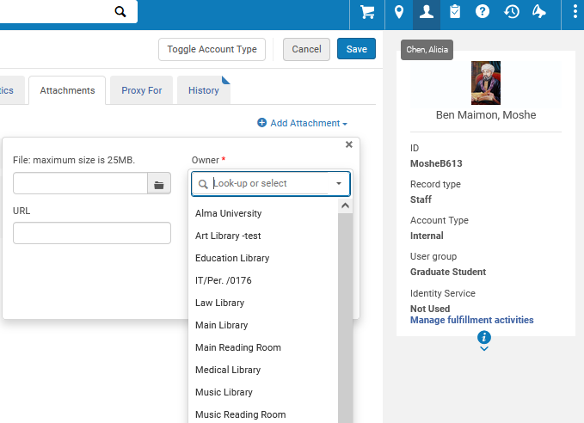
Creating and Viewing Attachments restricted by library
Staff user Alicia Chen can create Attachments for any library
All Libraries and institution
Staff User Alicia Chen

Slide 76
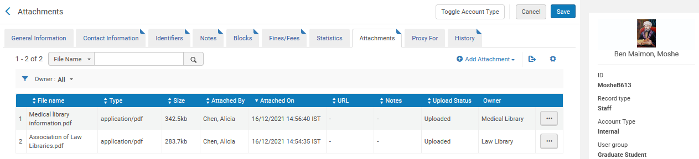
Creating and Viewing Attachments restricted by library
Patron Moshe Ben Maimon has Attachments in the Law Library and Medical Library.

Slide 77

Creating and Viewing Attachments restricted by library
Staff user Alicia Chen sees attachments in the Law Library and Medical Library.
Staff User Alicia Chen

Slide 78

Creating and Viewing Attachments restricted by library
Staff user Elly May Clampett sees attachments in the Law Library only.
Staff User Elly May Clampett
Law Library

Slide 79

Creating and Viewing Attachments restricted by library
Staff user Jethro Bodine sees attachments in the Medical Library only.
Staff User Jethro Bodine
Medical Library

Slide 80
xxx@exlibrisgroup.com

